Slide 1

Status 04.07.2022 — Morning
Work Group “Information Travel and Pandemics”

Slide 2
Requirements
Chose one of the figures to reproduce
Find parameters that can influence the model
Create a hypothesis

Slide 3
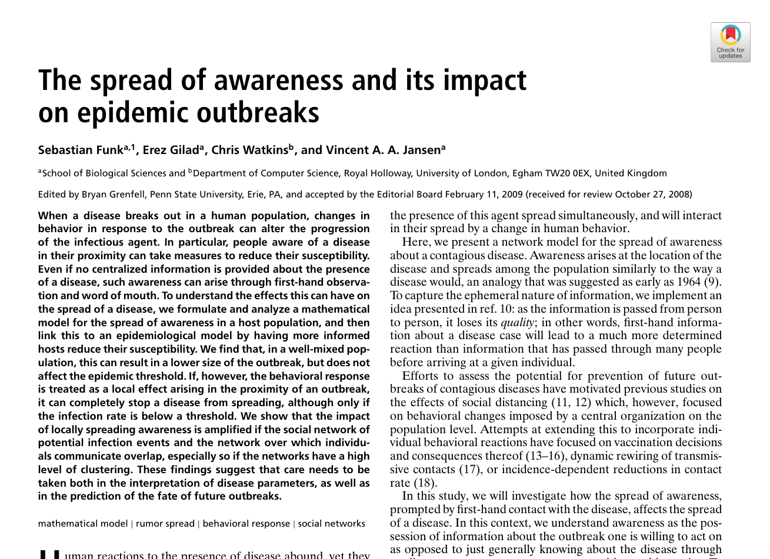
Paper of choice
FUNK, Sebastian, Erez GILAD, Chris WATKINS und Vincent A. A. JANSEN, 2009. The spread of awareness and its impact on epidemic outbreaks. Proceedings of the National Academy of Sciences of the United States of America. 21 April 2009. Bd. 106, Nr. 16, S. 6872–6877. DOI 10.1073/pnas.0810762106
We are working to reproduce Figure 4

Slide 4
Provisional Hypothesis
For a low detection rate (creating information from infections) a combination of a high rate of transmission for information, high rate of protection (reducing susceptibility) and a low dampening of information (both over distance and time) will lead to outbreaks being contained by the information. Introducing some non-local spreading of the infection can cause a non contained spreading of locally contained clusters of infections.

Slide 5
What we are trying to do
In our model we try to give people the SIR states in addition to their state of the information strength.
People with a strong information strength are less likely to get infected.
Information wanes with time and distance.
We are working on a grid with four contacts for every person

Slide 6
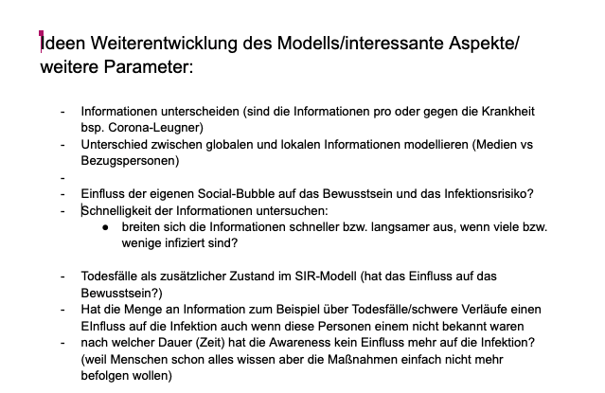
What we did
Brainstorming for possible influencing factors.
https://docs.google.com/document/d/1qIfoLsuGMMXVZ4Y72bZFURmOOd2Z6tohsn_cNpkNjAI/edit?usp=sharing

Slide 7
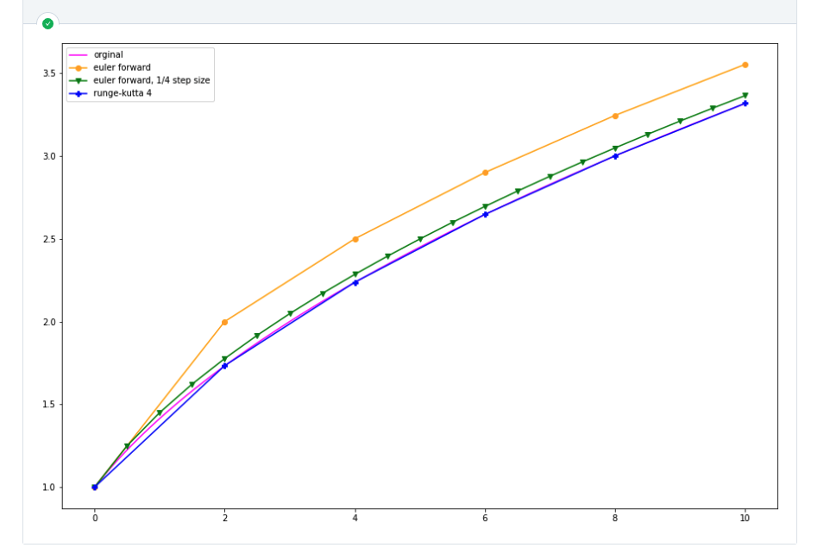
What we did
Comparison of mathematical models (Runge Kutta and Euler Forward)

Slide 8
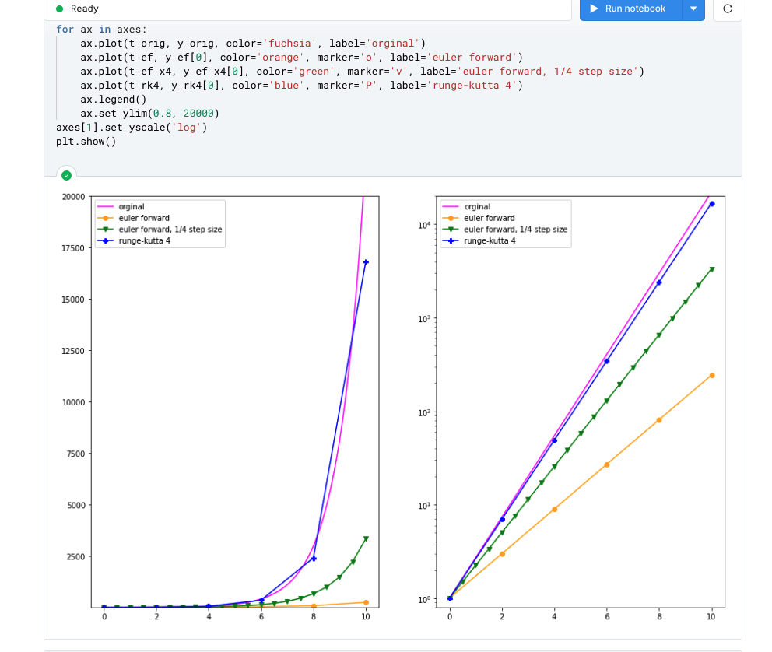
What we did
Comparison of mathematical models (Runge Kutta and Euler Forward)

Slide 9
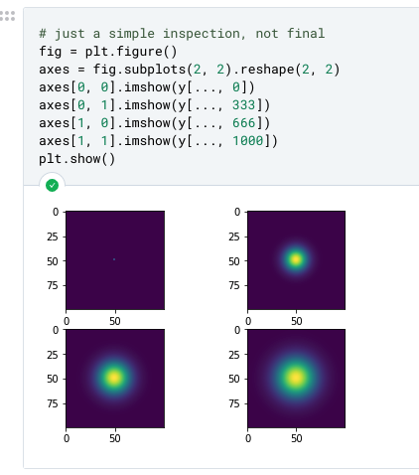
What we did
Proof of concept
(Heat distribution)

Slide 10
Working group goals for today
Finishing the first implementation of our chosen model

